Slide 1
Data Pipeline for Environmental Noise Contamination Detector
Todd Schultz, Sean Miller, Rahul Birmiwal
28 Nov 2018

Slide 2
Outline
Problem statement
Available data
Issues
Preliminary insight
Feature set options
Conclusions

Slide 3
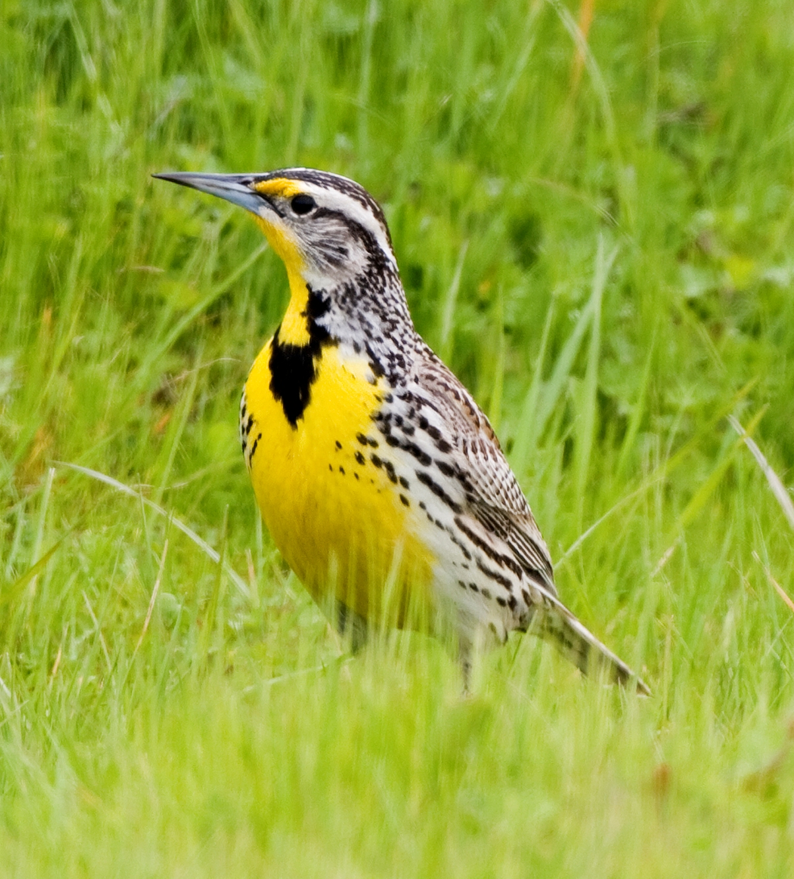
Problem statement
Aircraft certification requires flyover noise measurement
Environmental noise contamination is costly
Adds time to repeat required conditions
Potential to fail certification
Source include
Bird chirps
Wildlife/livestock vocalizations
Traffic noise
Use 3 engineers for monitoring
Kevin Cole from Pacific Coast, USA CC-BY 2.0

Slide 4
Proposal
Create an automated environmental contamination detector based on acoustic signals
Feasibility study
What’s the potential?
Roughly best feature set
Roughly best algorithm

Slide 5
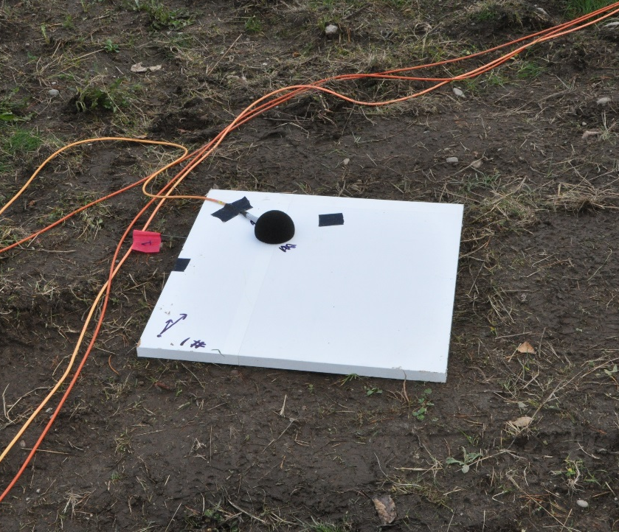
Available data
Time series audio recordings near major international airport
Represents 3 days of measurement
One day each in November 2017, December 2017, and January 2018
49 aircraft recordings
7 wildlife noise
10 ambient
Microphone installation

Slide 6
Available data
Professional recorded and labeled wave files
Wind screen used to reduce wind noise
No missing time series data points
Recorded at 51.2k samples/second
Usable bandwidth from 4.6 Hz to 20 kHz
Scientific instrumentation grade equipment
Pressure amplitudes have been normalized for public release
Feature selection will normalize again to remove overall signal energy
Done to remove sound level variation due to propagation distance

Slide 7

Available data
Bird chirp (bird01.wav)
Jet aircraft (plane8.wav)

Slide 8
Issues
Propagation distance effects on amplitude
Normalize time-series levels
Normalize features to remove signal power
Imbalance between classes
More clean aircraft signatures than contaminated
Public domain recordings for wildlife vocalizations exist
Superposition to create new, contaminated signal
Can use to test performance versus signal-to-noise ratio
Data management
Each signal will produce 50-100 blocks of features
Each block of features maybe 10-1,000’s of features

Slide 9
Preliminary insights-octave spectrum
Bird chirp (bird01.wav)
Jet aircraft (plane8.wav)

Slide 10
Preliminary insight
Octave spectrum
10 bands = 10 features per octave spectrum
31.5, 63, 125, 250, 500, 1000, 2000, 4000, 8000, 16000 Hz bands
Spectrum shape visibly different for bird and aircraft
Spectrum shape of aircraft changes as function of position relative to microphone
Thoughts
May need to extract representative blocks and remove ‘quiet’ blocks
Need to ensure sample blocks of the directivity of aircraft noise

Slide 11
Feature set options
Numerous options available for feature generation
(1/n) Octave band spectrum
Cepstrum
Short-time Fourier Transform
Wavelets
?

Slide 12
Conclusions
Time series data is ready
Data management could be cumbersome
Time series signals may require pre-processing
Many feature generation options available
Project goal supports testing a vary of feature choices

